Slide 1
UKORGANIC
CONFERENCE - 14th MARCH 2024
Launch of UK ORGANIC – Adrian Carne

Slide 2
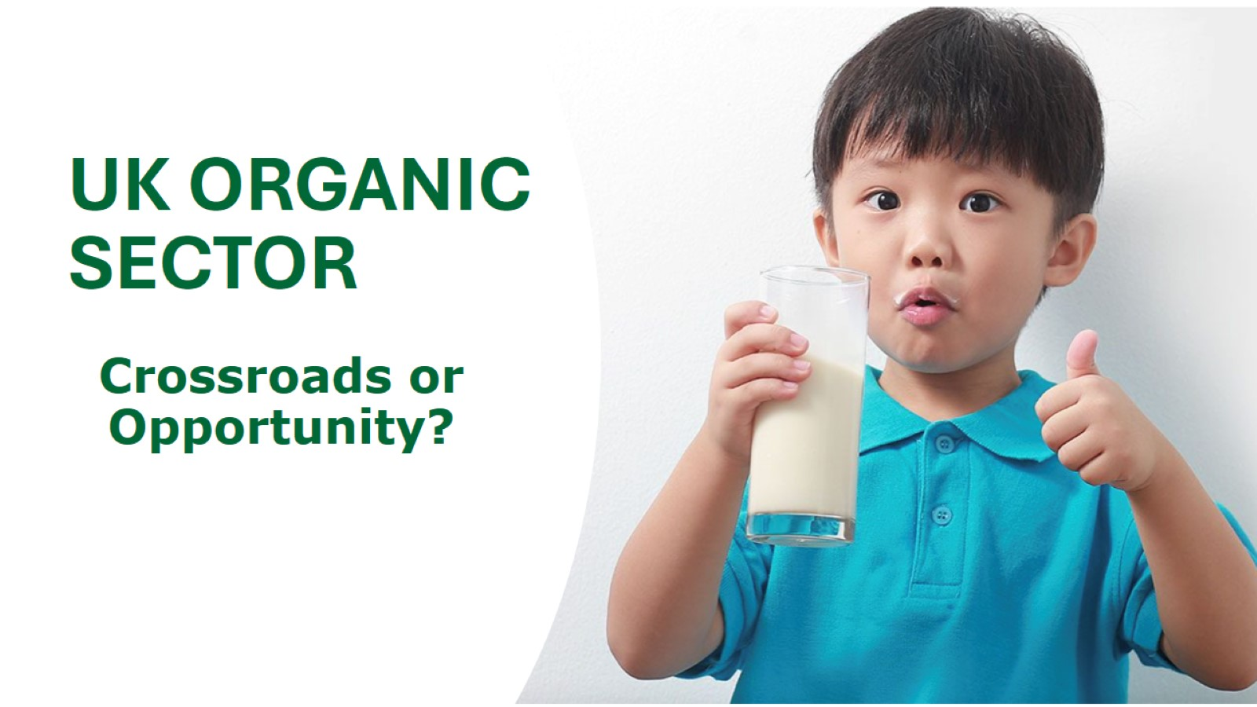
UK ORGANIC SECTOR

Slide 3
To be discussed:

Slide 4
Notes:
Founded in 2009 with the ambition to consolidate the efforts of the organic sector and to raise awareness and grow sales of organic F&D in the UK
Independent trade organisation with circa 120 paying members at the heart of its success
Works towards a unified voice for the sector to achieve common goals
Has made useful and meaningful in-road in to raising the awareness and importance of the sector
Secured three (=9 years) successive EU funds to invest in marketing campaigns
More recently it has coordinated member funded campaigns, but funding has been insufficient to drive meaningful engagement

Slide 5
WHY DO WE CARE?
Notes:
However….you’re probably not worrying enough!
Organic farming is the ‘gold standard’
Organic farming is a defined system with quantifiable climate and biodiversity outcomes that will bring about transformational change
Organic farming isn’t ‘tinkering around the edges’
Everyone can learn from organic – it isn’t the only answer, but it does represent a necessary change in mindset and as a defined system drives the necessary innovation needed to address today’s challenges
Consumers deserve to have the option to eat, drink, wear and use products that have been grown without the use of man-made harmful chemicals and that delivers positive health for themselves, their families, animals and the planet

Slide 6
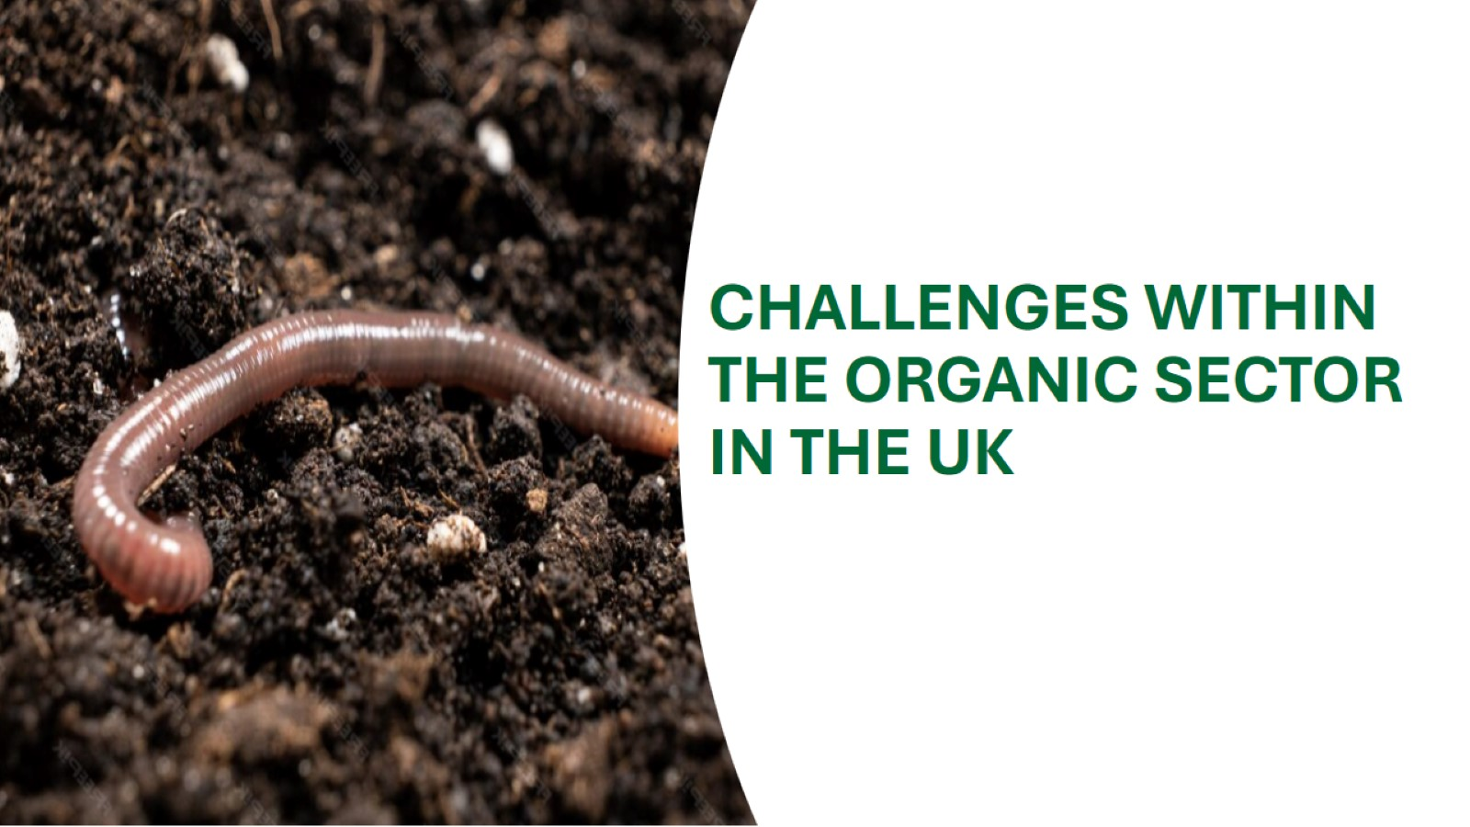
CHALLENGES WITHIN THE ORGANIC SECTOR IN THE UK or Crossroads?
Notes:
The forthcoming pages will share the main challenges we are facing

Slide 7
Notes:
EU agricultural promotion policy budget is €185M annually
in 2022 10.4% EU agricultural land area was farmed organically, Number of organic producers in the EU grew 9.4% between 2021 and 2022 AND sales in organic food and drink doubling between 2015 – 2020 to €55B. UK land area in 2022 was 3% of total agricultural land area (DEFRA) – UK just being left behind!
The Netherlands government recently announced €26M to support organic. On a per capita basis that is equivalent to £88M in the UK
USDA has allocated $300M to grow better markets and new income streams as part of the Organic transition Initiative

Slide 8
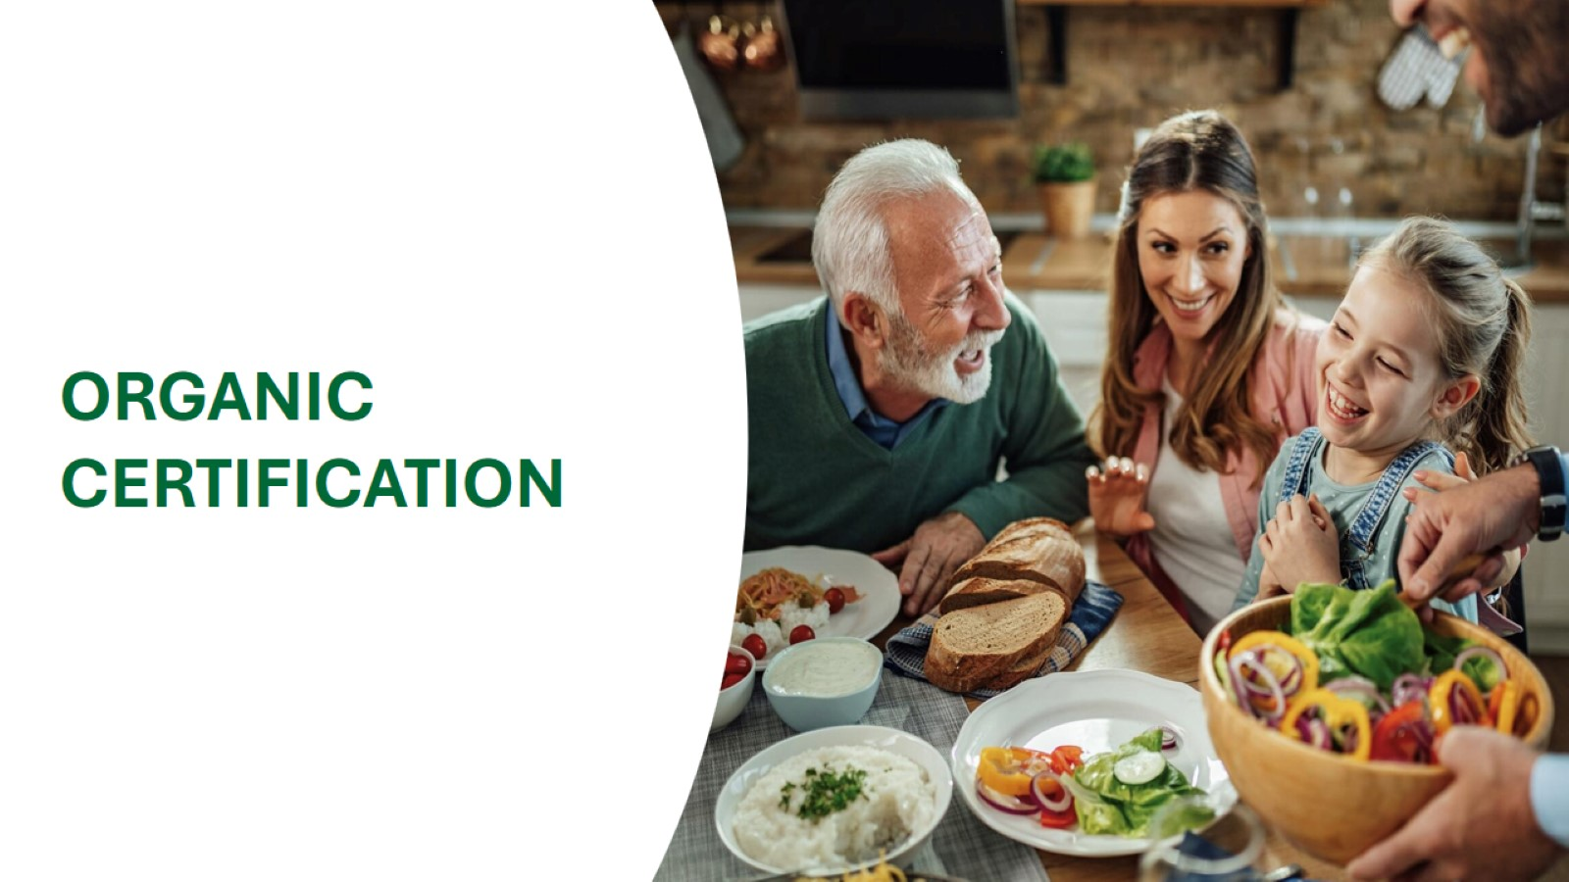
Notes:
Six organic certifiers in UK with differing aims and objectives
Soil Association Certification
Organic Farmers and Growers
Quality Welsh Food Certification Ltd (Regional)
OF&G (Scotland)/Scottish Organic Producers Association (SOPA) (Regional)
Biodynamic Association (Demeter)
Organic Food Federation (Specialist importers)
Plus for nonfood we also have different standards GOTS (textiles), NATRUE, COSMOS (cosmetics)

Slide 9
MULTIPLE ORGANISATIONS, NGOs, CHARITIES AND OTHER STAKEHOLDER GROUPS
Notes:
Organic Trade Board (Trade Association), now UK Organic Association CIC
Food and Drink Federation Organic Group (Trade Association)
Organic Research Centre (Charity)
DEFRA specialist group
English Organic Forum
Welsh Organic Form
Scottish Organic Stakeholders Group (previously Scottish Organic Forum)
Organic Growers Alliance (Peer-to-Peer Support Network)
NFU Organic Forum
The certifiers
Plus at least 20 more………

Slide 10
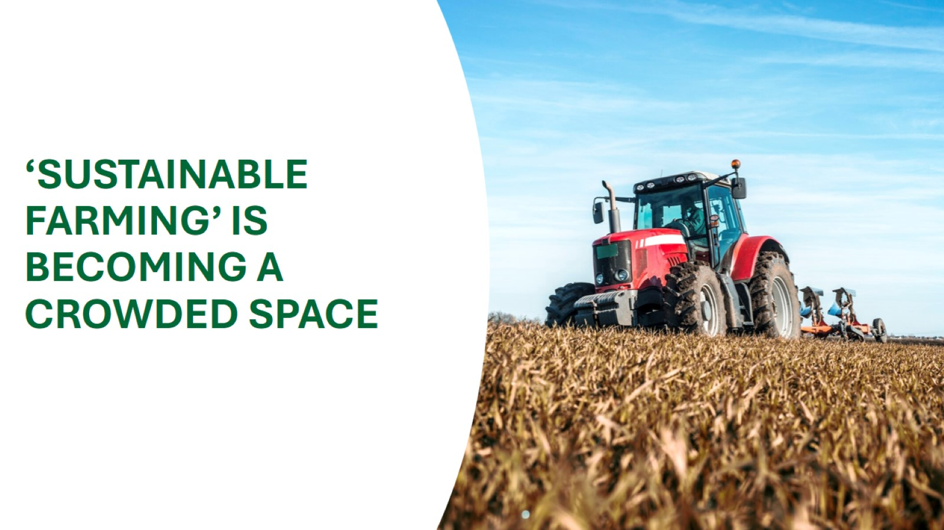
‘SUSTAINABLE FARMING’ IS BECOMING A CROWDED SPACE
Notes:
Regenerative Farming
Wild Farmed
Pasture for Life
RSPCA Assured
Red Tractor
Sustainable Food Trust
Linking Environment and Farming (LEAF)
Organic - Organic is unique – it has internationally recognition, legally binding standards. With the entire supply chain annually audited it guarantees integrity and veracity alongside quantifiable outcomes

Slide 11
Notes:
Better for animal welfare
Better for the environment
More sustainable
Health benefits
Better quality
No harmful pesticides and chemicals
Pays the living wage
Taste is better

Slide 12
Notes:
No clear single-minded and consistent message on the benefits and value of organic
‘Boundaries’ of sustainability offer increasingly becoming blurred with evidence of ‘greenwash’ from some challenger offers
Unclear pricing position in the market
Perceived by many as elite
Poor availability
No recognisable organic logo conveying the values of organic. Low recognition levels of commonly used UK organic logos

Slide 13
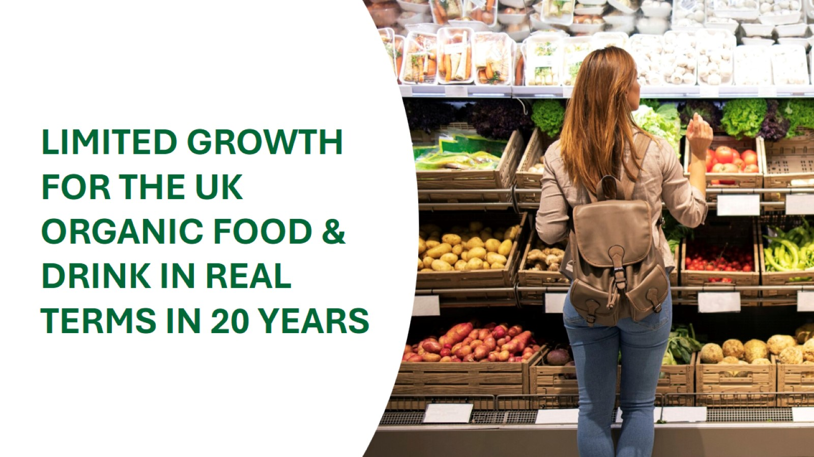
Notes:
Consumer spending on food and drink in the UK 2005 – 2022 has grown from £60B to £105B (75% growth in value)
Consumer spending on organic food and drink in the UK 2005 – 2022 has grown from £2B to £3B (50% growth in value)
This shows a decline from 3.3% to 2.8% share of total sales
The recent change in farm payments to deliver better environmental outcomes through Sustainable Farming Incentive (SFI) and Countryside Stewardship plus (CS+) will see more farmers transition to organic in a stagnant UK market
Organic sales 2023 vs 2022 grew of 2.2% (adjusted with inflation it is actually a decline of about 2%). Volumes are down 6.7% YoY

Slide 14
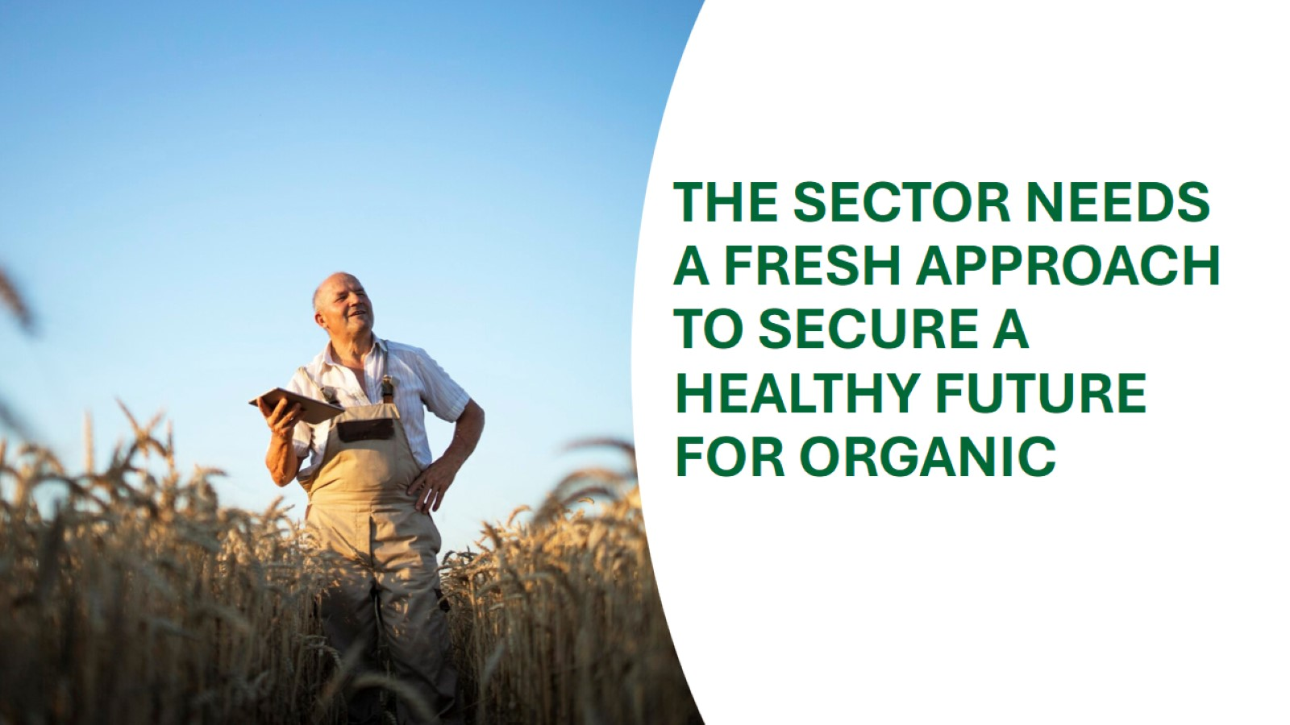
?

Slide 15
“If we always do what we’ve always done, we will always get what we’ve always got!” Henry Ford

Slide 17
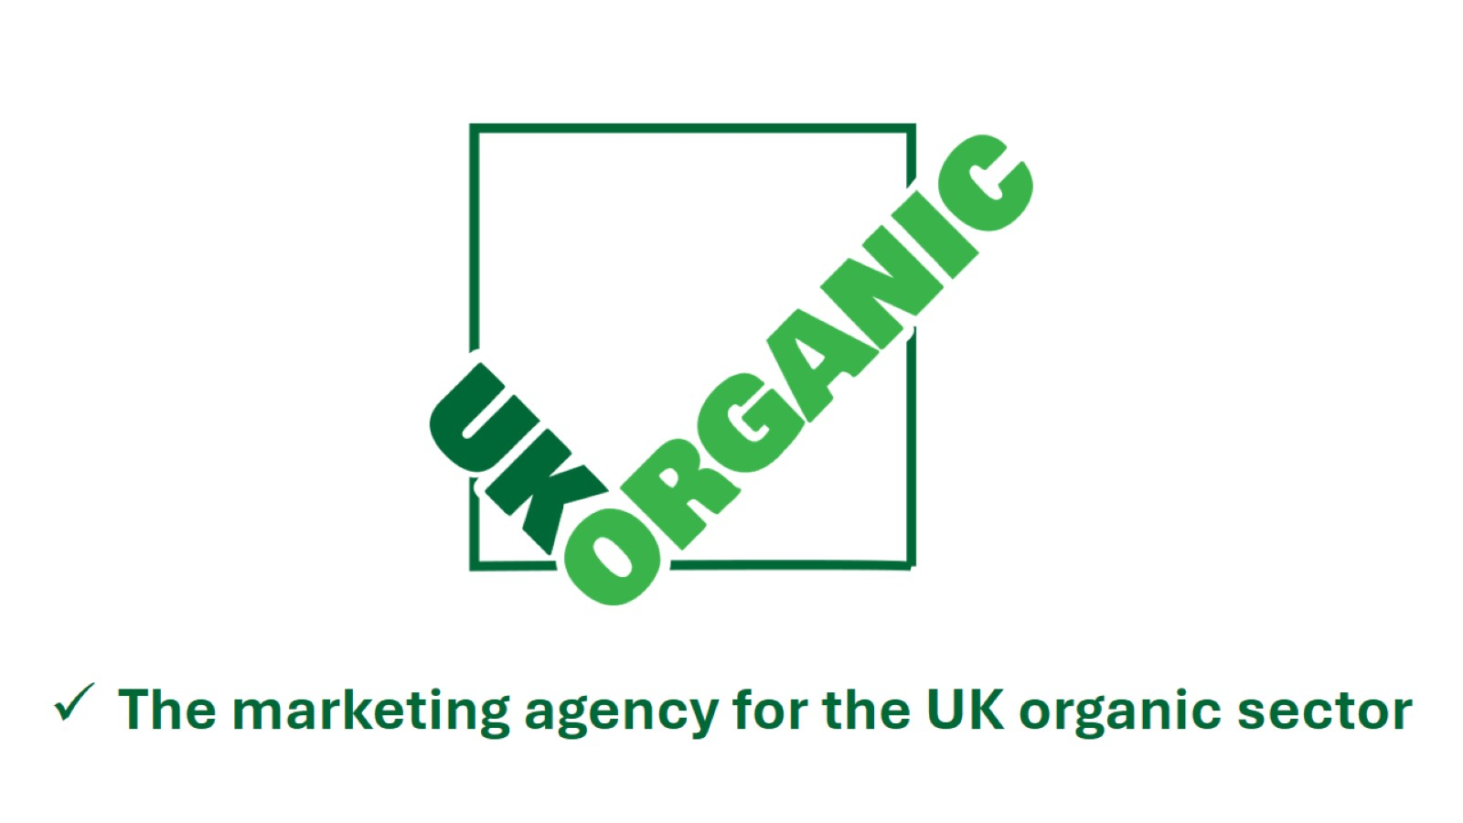
Notes:
Under the new name of UK Organic (association), and with new CIC not-profit status it’s a truly independent organisation, it will be relevant, representative, inclusive and non-competitive. It will represent all UK certified stakeholders across the complete supply chain
UKO will position itself as the MARKETING AGENCY FOR THE ORGANIC SECTOR IN THE UK. Will be an expert research, communications and branding team that will be the key organisation to lead the organic industry in practical knowledge, consumer insights and trade focus. UKO will brand ‘organic,’ develop consumer marketing campaigns; brief PR for the sector and engage with trade and retail; UKO will grow the sector in the UK
More into the specific:
UKO strives to raise awareness of the benefits of organic farming and production for consumers and the environment, empowering consumers to make more informed choices that will grow the sector in the UK will focus on a single approach to market ‘brand organic’ as a ‘brilliant basic’, which will liberate consumer brands and products to tell their own stories and create their own brand comms
UKO advocates for an organic systems approach that simultaneously enhances animal welfare, environmental outcomes and soil quality
UKO will develop a consumer message that only organic can claim and that can align, develop and communicate a marketing platform for ‘brand organic’ ensuring that assets are available for organisations to use if required
UKO will support the initiatives to create a single supporting organic logo that consumers will recognise and to work with external organisations to introduce and roll out a preferred voluntary environmental label
UKO will lead the organic industry in practical knowledge and consumer insights and will align, collaborate and work with all certifiers, NGO’s/stakeholders, producers, manufacturers (brands) and retailers to grow the organic market by raising awareness and creating demand of certified organic products through the long-term commitment to a consumer activation and communication program
UKO will cut-through multi layered constraints and complexities in the sector and consolidate support
UKO will agree a baseline to build/align the key interests/objectives of the many groups in organic sector and if required will provide an operational and organisational space that can facilitate consolidation of the complexity from within the sector

Slide 18
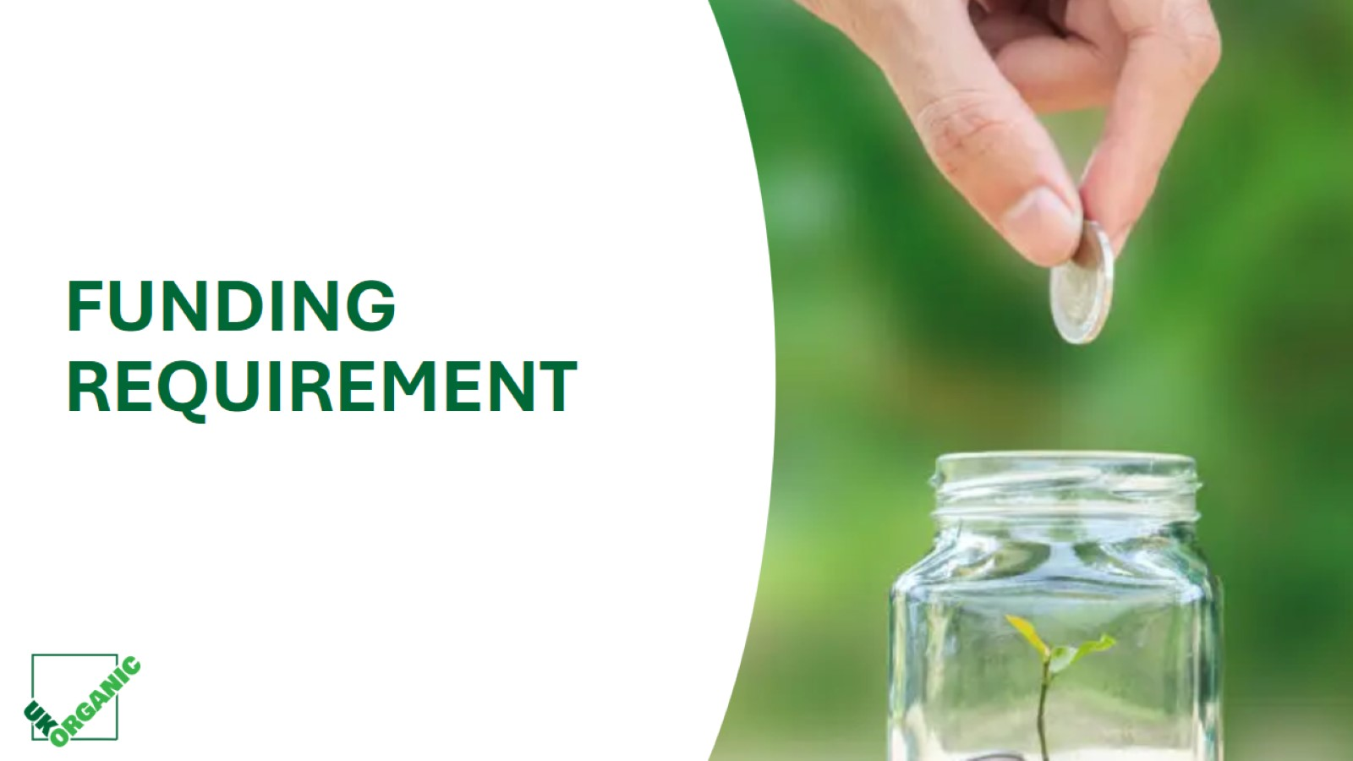
Crisis FUNDING REQUIREMENT ?
Notes:
The UK Organic operating costs will not be funded by membership fees, pledges from manufacturers, brands and retailers (as OTB was). The sector needs these organisations to use their budgets to activate their own brand plans (using any created marketing assets as desired)
For the UKO operating costs will seek funding from external stakeholders. We will use our new fund-raising capability and wider stakeholder profile/status to develop an alternative funding mechanic from trusts, HNW individuals, philanthropic foundations etc to finance an independent (non-partisan), research, communications, branding, marketing and trade facing team.
The UKO activation will seek to secure central funding from AHDB, DEFRA and available EU budgets to finance the ‘brand organic’ marketing activity, raise awareness and create demand of certified organic products through a strategic and long-term commitment to a consumer activation and communication program
Additional tactical marketing to drive additional central activation to be funded by Affiliate ‘Supporters’ program

Slide 19
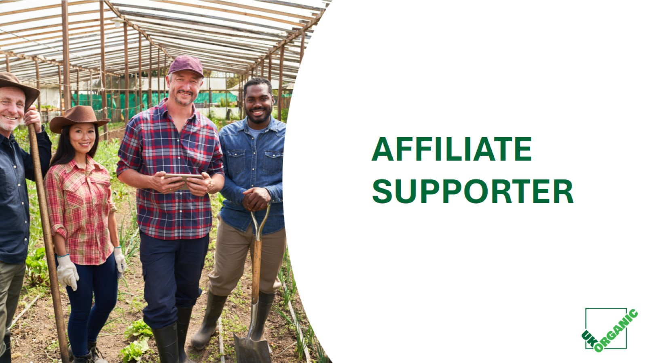
Notes:
The UK Organic operating costs will not be funded by membership fees, pledges from manufacturers, brands and retailers (as OTB was). The sector needs these organisations to use their budgets to activate their own brand plans (using any created marketing assets as desired)
For the UKO operating costs will seek funding from external stakeholders. We will use our new fund-raising capability and wider stakeholder profile/status to develop an alternative funding mechanic from trusts, HNW individuals, philanthropic foundations etc to finance an independent (non-partisan), research, communications, branding, marketing and trade facing team.
The UKO activation will seek to secure central funding from AHDB, DEFRA and available EU budgets to finance the ‘brand organic’ marketing activity, raise awareness and create demand of certified organic products through a strategic and long-term commitment to a consumer activation and communication program
Additional tactical marketing to drive additional central activation to be funded by Affiliate ‘Supporters’ program

Slide 20
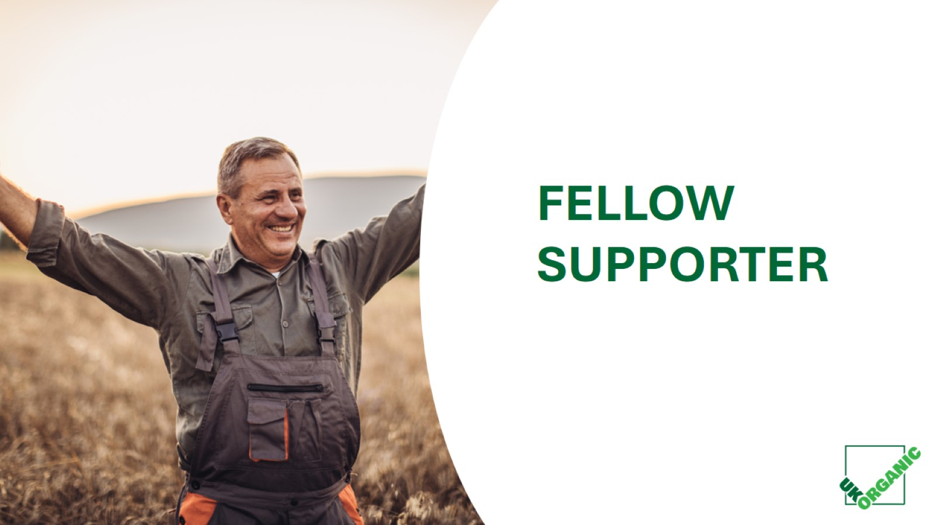
Notes:
In order to be more representative and inclusive, we are offering free Fellow Supporters membership for all organic operators and producers in the UK (over 5,500 certified businesses), all that needs to be done is signing up to our database. Among others you will receive:
Automatic inclusion
Monthly sector newsletter
Annual Consumer Market Report - key insights
Marketing toolkits and assets to use and adapt
Campaign and messaging updates
Remote participation to our Annual conference with option to buy tickets
Be part of the movement

Slide 21
Notes:
UKO will collaborate and work with all certifiers, NGO’s/stakeholders, producers, manufacturers (brands) and retailers to grow the organic market
UKO will simplify the organic message for consumers and introduce assets that better communicate the benefits of organic
UKO will raise awareness of, and create demand for, certified organic products through a strategic and long-term commitment to a consumer activation and communication program
UKO will work with the trade and retail to develop plans for instore promotion and activation
UKO will connect organic businesses, provide space for collaboration and will consolidate the effort and activity of the sector
Clarity over sector roles, effort and outputs
UKO will have a strong trade/retail agenda
An initiative that will not be funded solely by membership or pledges

Slide 22
WHAT’S IN-SCOPE FOR UKORGANIC?
Notes:
Be the marketing agency for the UK organic sector - Creation of a long-term consumer awareness, activation and communication program (supported by press/PR/social media), that would grow consumption/usage of organic products
Create ‘brand organic’ marketing assets for stakeholders
Develop trade plans with retail sector to drive growth
Support the introduction and adoption of labels and logos that better communicate the benefits of organic
Foster relationships with brand owners
Create partnership away-days
Establish strategic collaborations amongst brands
Support export strategy for UK organic sector
Network with other consumer and international trade associations to create scale and learn best practice

Slide 23
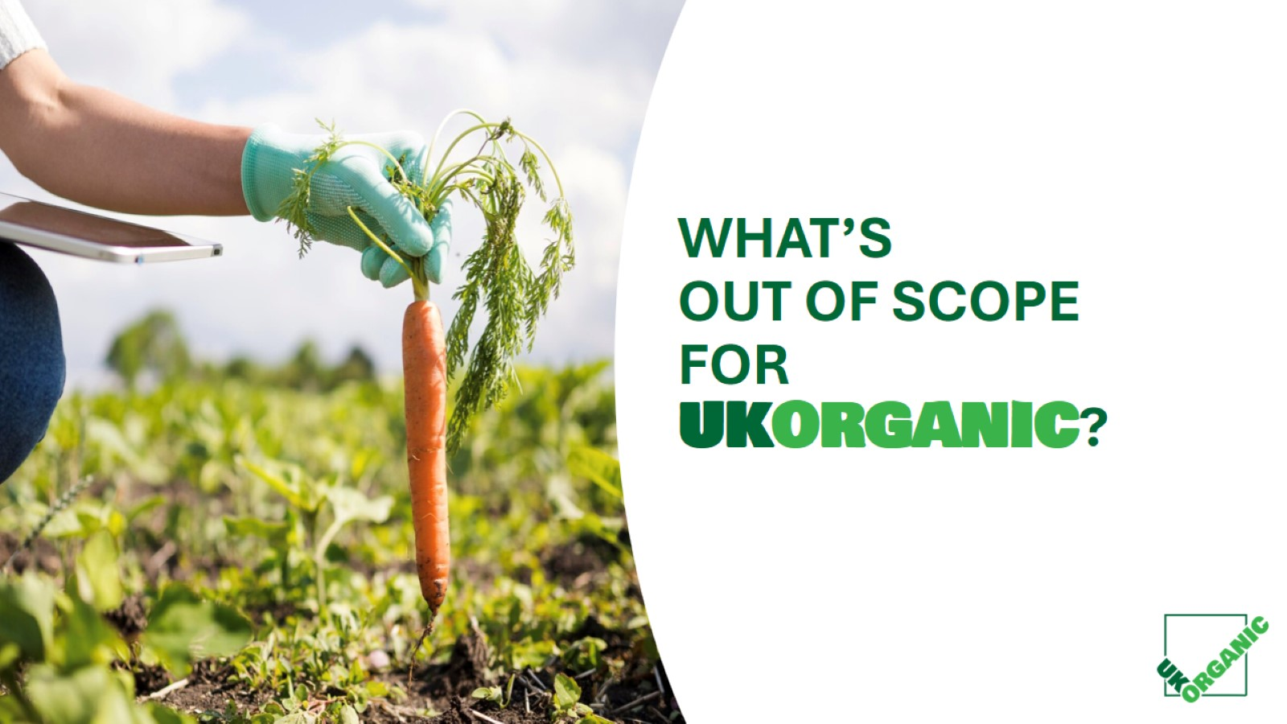
Notes:
Negotiating international equivalences
Harmonising certification standards
Setting organic policy
Agreeing EU or other international trade deals
Supply chain failure

Slide 24
Notes:
Opportunity to build wider portfolio of activity
Establishes UK Organic as UK’s leading independent (non-partisan) organic researcher across all aspects of the organic supply chain – ‘farm to fridge’
Seek and support wider opportunities to collaborate with key partners (e.g. research bodies, farmers and academic institutions)
Lead the organic sector in knowledge exchange
Work alongside farmers and certification bodies to support organic farming policy making and farm experiences
Encourage organic community to provide support to farmers and consumers through real world organic experience

Slide 25
Notes:
not aligned on a single message, in real terms sales are going backwards, retailers have switched off and there is little or no central government support for the sector
The good news - we have a plan: – evolve OTB into a new CIC organisation called UK Organic. UKO is a ‘marketing agency’ for the UK Organic sector that will work to align the organic sector, raise awareness of the benefits of organic and to grow the sector in the UK
Funding will be innovative and different, and we will involve central government. All organic producers will be members and those that want to be can be more involved. There will be clarity over roles, effort and outputs and a single-minded effort to create a long-term consumer awareness, activation and communication program that will engage retailers and trade and will grow the consumption and usage of organic products
There will be a strong trade and retail agenda creating momentum for promotion, ranging, trial and advocacy
Finally – UK Organic will be a strong and relevant independent organisation that can provide a space for further consolidation of effort and activity in the sector

Slide 26
ALIGNING THE STARS
Notes:
Key Milestone - UK Organic launch, management of key stakeholders, announcement and sharing of plans (today - March 14th)
Engage trade to support and invest in the plan (February)
FUNDING
EU funding plan and vehicle for application (February)
EU exporters group and UK Importers group (February)
AHDB/DEFRA matched investment (February – March))
HNW Individuals/Trusts/Philanthropic Foundations (February - April)
Press/comms management (March –May)

Slide 27
“Build it and he will come”

